Slide 1
Effects of reduced-sodium, added-potassium salt substitute on stroke – the salt substitute and stroke study (SSaSS)
Professor Bruce Neal
Executive Director
The George Institute, Australia

Slide 2
Sodium, potassium and salt substitute
Both higher sodium consumption and lower potassium consumption are associated with higher BP levels.
Randomised trials show clear BP lowering effects with reduced dietary sodium or added dietary potassium.
Salt substitutes combine the two effects with clear benefits for BP in randomised trials.
But
Effects of salt substitutes on cardiovascular events unproven
Salt substitution carries a theoretical risk of hyperkalaemia
Concerns raised about reducing dietary sodium intake

Slide 3
Salt Substitute and Stroke Study (SSaSS)
The primary aim was to define the effect of salt substitute versus regular salt on stroke
The secondary aims were to define the effects on:
Major adverse cardiovascular events
Total mortality
The safety outcome was hyperkalaemia
Endpoint adjudication masked to treatment allocation for all outcomes
Participants and recruitment
600 villages and about 35 participants from each village
Adults with history of stroke, or
Age 60+ years with poorly controlled BP
No self-reported history of severe kidney disease, use of potassium supplements or use of potassium sparing diuretics
No blood test for renal function or serum potassium

Slide 4
Design
Pragmatic, large-scale (n=20,995), open, cluster randomised trial
Salt substitute (75%NaCl, 25%KCl) versus regular salt (100%NaCl)
Randomisation
6-monthly follow-up for all
(routinely collected health data and in-person years 0, 1, 2 and 5)
Recruitment and baseline data
(in person)
300 villages (n=10504) salt substitute
300 villages (n=10491) regular salt
Annual in-person measurement of blood pressure and urinary electrolytes
(in a subset of 54 to 140 villages)

Slide 5
Statistical power and analysis
90% power (p=0.05) to detect a 13% lower risk of stroke with salt substitute compared to regular salt. Assumptions:
  3.0mmHg BP lowering
  3.5% p.a. primary outcome event rate
  Cluster randomisation of 600 villages in 1:1 ratio
  Intra-cluster correlation coefficient =0.04
Primary analysis using Poisson regression, adjusted for clustering by village with rate ratios, 95%CIs and p-values calculated
Control for multiple testing across primary and secondary outcomes was done using the Benjamini-Hochberg approach
The Kaplan Meier method used to generate cumulative event curves

Slide 6
Participant characteristics
 | Salt substitute | Regular salt
Age (years), mean | 65 | 65
Women, % | 50 | 49
Education beyond primary, % | 28 | 27
History of stroke, % | 73 | 72
Uncontrolled blood pressure, % | 59 | 59
Diabetes, % | 11 | 11
Hypertension, % | 89 | 88
ACE/ARB, % | 23 | 23
Calcium antagonist, % | 43 | 41
Any antihypertensive, % | 80 | 79
Mean blood pressure, mmHg | 154/89 | 154/89
Mean 24-hour urinary sodium, mmol (g)* | 191 (4.4) | 182 (4.2)
Mean 24-hour urinary potassium, mmol (g)* | 36 (1.4) | 36 (1.4)
*calculated from subset of 539 individuals with complete baseline 24-hour urine collections.
Source: Neal, Am Heart J 2017

Slide 7
Follow-up and intermediate outcomes
Follow-up
Mean follow-up 4.74 years
100% vital status for all participants
99.9% complete follow-up for non-fatal outcomes
At 5 years, 92% intervention group still using salt substitute and 6% control group started using salt substitute
Average effects of salt substitute versus regular salt
Systolic BP -3.3 (95%CI -4.5 to -2.2) mmHg
Diastolic BP -0.7 (95%CI -1.4 to 0.05) mmHg
24-hour urinary sodium -15 (95%CI -24 to -6.7) mmol
24-hour urinary potassium 20 (95%CI 18 to 23) mmol

Slide 8
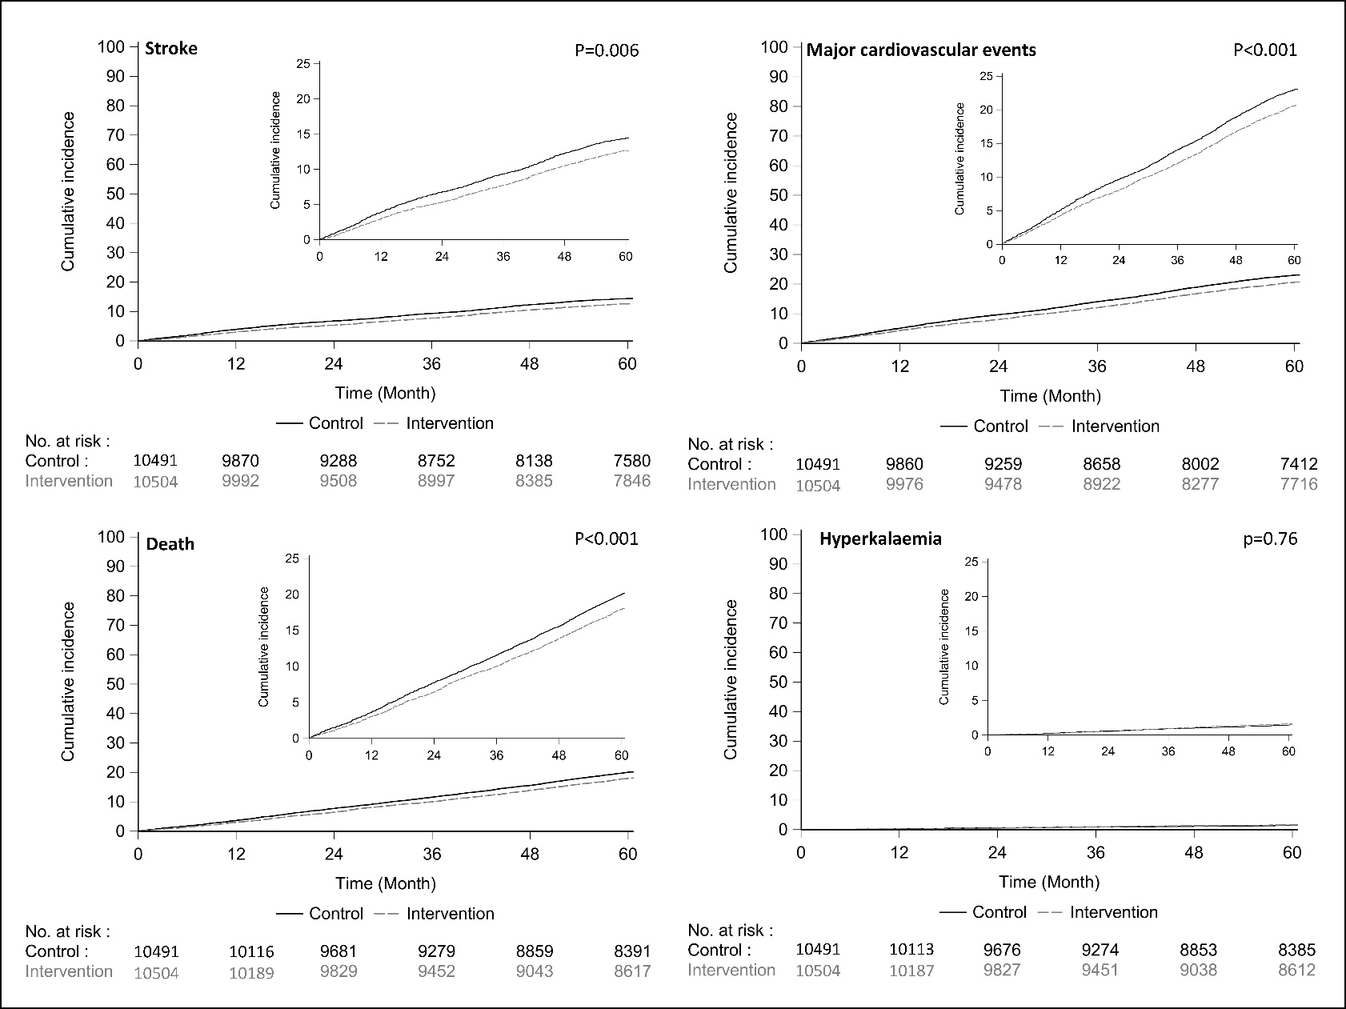
Stroke
Total events = 3123
Participants with event = 2678
Rate ratio = 0.86 (0.77 to 0.96)
P value = 0.006

Slide 9
Major adverse cardiovascular events
Total events = 5241
Participants with event = 4499
Rate ratio = 0.87 (0.80 to 0.94)
P value <0.001

Slide 10
Total mortality
Total events = 4172
Participants with event = 4172
Rate ratio = 0.88 (0.82 to 0.95)
P value <0.001

Slide 11
Hyperkalaemia
Total events = 331
Participants with event = 315
Rate ratio = 1.04 (0.80 to 1.37)
P value = 0.76
Sudden vascular death
Rate ratio = 0.94 (0.82 to 1.07)

Slide 12
Effects on stroke in subgroups
All p homogeneity >0.20

Slide 13
Strengths and weaknesses
Large-scale, long term, definitive outcomes
Pragmatic risk screening
Scalable and low-cost intervention
Good power for key subgroups
Population selected to be amenable to salt substitution
Record linkage was likely imperfect
Did not replace all dietary sodium
No potassium measurement only clinical hyperkalaemia
No assays of kidney function
Done in a single country

Slide 14
Potential health impact China
Comparative risk assessment modelling
Nationwide implementation of salt substitution in China
 | Current events in | Events averted
 | China (000s) | In 000s | % of current
Cardiovascular deaths | 4201 | 461 | 10.9
Non-fatal strokes | 4022 | 365 | 9.1
Non-fatal heart attacks | 1546 | 147 | 9.5
TOTAL | 9769 | 973 | 10.0
Source: Marklund, BMJ 2020

Slide 15
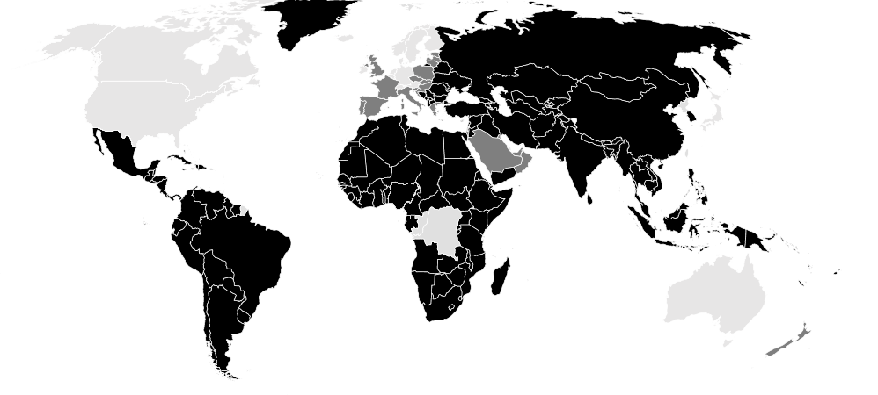
Potential health impact worldwide
Relevant to everyone that eats salt
Most relevant to the >5 billion people consuming most of their dietary sodium as ‘discretionary’ salt
>50% dietary sodium consumed as discretionary salt
25-50% dietary sodium consumed as discretionary salt
<25% dietary sodium consumed as discretionary salt
Source: Bhat, Adv Nutr 2020

Slide 16
Conclusions and potential implications
SSaSS provides a definitive result - salt substitute is effective for the prevention of stroke, major cardiovascular events and premature death with no evidence of harm
Implementation strategies
Salt manufacturers and retailers worldwide could switch to producing and marketing salt substitute at scale
Food processing industry worldwide could reformulate products to lower sodium and higher potassium compositions
Governments worldwide could design polices to promote salt substitute and discourage regular salt use
Consumers worldwide could cook, season and preserve foods with salt substitute not regular salt

Slide 17
Acknowledgements
Management Committee
Bruce Neal (Chair), Yangfeng Wu, Paul Elliott, Lijing L. Yan, Nicole Li, Darwin Labarthe andd Maoyi Tian.
Data and Safety Monitoring Committee
Rory Collins (Chair), Zhengming Chen, Jonathan Emberson, Peter Sandercock, Paul Whelton supported by Sandrine Stepien.
Endpoint Adjudication Committee
Jie Yu (Chair), Weiping Sun, Junyan Liu, Fang Liu, Yun Jiang, Rong Hu, Yong Peng and Jiehui Shan
Local Investigators, Project Operations Group and Analysis Team
Xiangxian Feng, Ruijuan Zhang, Yuhong Zhang, Jingpu Shi, Jianxin Zhang, Liping Huang, Zhifang Li, Yan Yu, Yi Zhao, Bo Zhou, Jixin Sun, Yishu Liu, Xuejun Yin, Zhixin Hao, Ka-Chun Li, Xinyi Zhang, Peifen Duan, Faxuan Wang, Bing Ma, Weiwei Shi, Gian Luca Di Tanna, Sandrine Stepien, Sana Shan, Sallie Pearson, Yanqing Wang, Ying Cai, Lili Wang, Baoyu Shan, Tianqi Hu, Ms Yang Shen, and Zhuo Meng.
All the study participants, and
The National Health and Medical Research Council of Australia

Slide 18
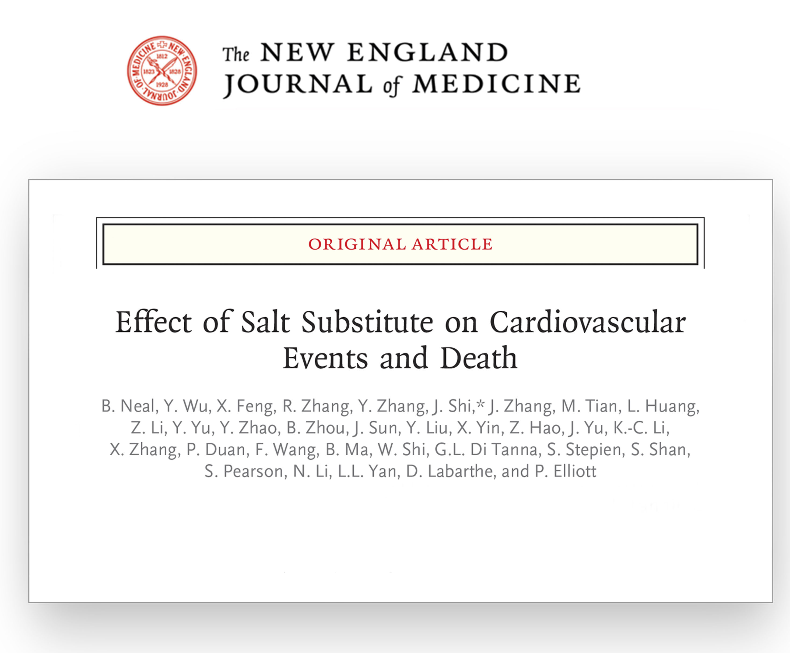
Journal publication
Thank you

Slide 19
Effects of reduced-sodium, added-potassium salt substitute on stroke – the salt substitute and stroke study (SSaSS)
Professor Bruce Neal
Executive Director
The George Institute, Australia
bneal@georgeinstitute.org.au

